Slide 1




Review-I
Exploring OFDM using USRP B210
Capstone Project – Introduction (PROJ2999)
AY 2025-26
GITAM (Deemed-to-be) University
Department of Electrical Electronics and Communication Engineering
Project Team:
Project Mentor:
Navyashree J - BU22EECE0100455
K Sanjana - BU22EECE0100457
Shreya H B - BU22EECE0100463
Dr. Ramesh M
Project In-charge:
Jaya Prakash sahoo
www.gitam.edu
Dept EECE, GST Bengaluru ¹

Slide 2

Objective and Goals
Objective
The main objective of this project is to study and understand Orthogonal Frequency Division Multiplexing (OFDM) and implement it using the USRP B210 hardware with GNU Radio. The aim is to see how OFDM works in real-time communication, test its performance, and learn its importance in systems like 4G, Wi-Fi, and 5G.
Goals
Main Goals
Design OFDM transmitter and receiver chain.
Implement OFDM blocks in GNU Radio.
Integrate design with USRP B210 hardware.
Perform real-time transmission and reception.
Validate BER (Bit Error Rate) and spectral performance.
Additional Goals
Extend implementation for channel estimation and equalization.
Explore scalability towards MIMO-OFDM.

Slide 3
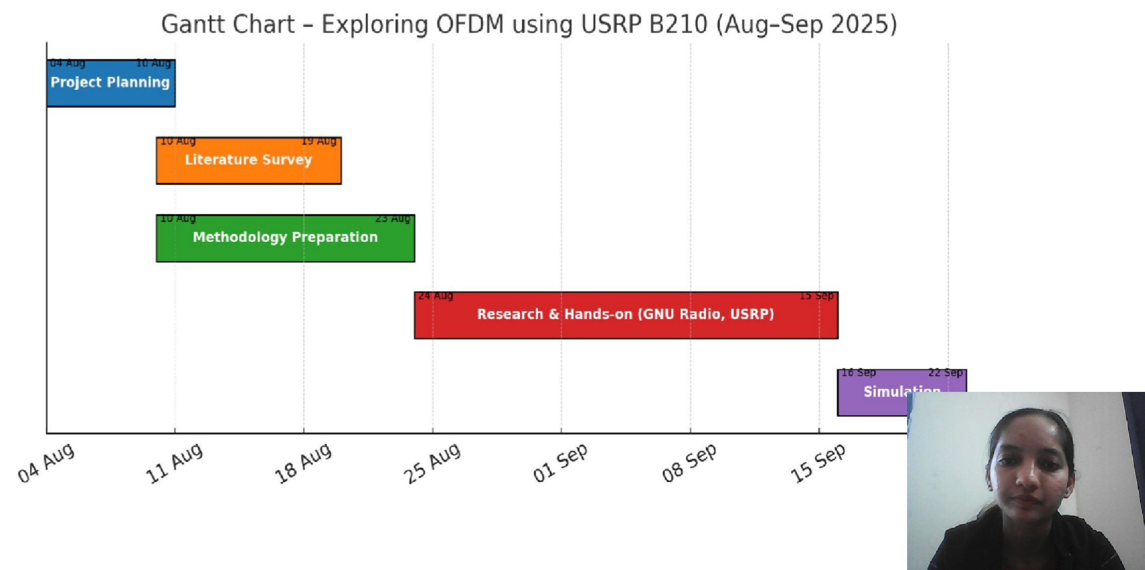
Project Plan (Clearly mention milestone for objectives under each reviews)
Gant Chart - Milestones and Activities

Slide 4

Literature Survey
Key Publications
P. Sure et al., “A survey on OFDM channel estimation techniques,” Elsevier, 2017
Survey of pilot-aided and frequency-domain channel estimation methods, useful for implementing OFDM channel estimation.
“USRP Based Digital Audio Broadcasting Using OFDM in Virtual and Remote Laboratory,” 2019 Journal/Source: IEEE Access / LabVIEW & SDR educational setup
Key Insight: Applied OFDM for audio transmission in Digital Audio Broadcasting (DAB) using USRP 2901. Demonstrated system flexibility for multimedia applications. Provides insight into system parameter optimization for non-data applications.
“Performance Analysis of an OFDM PHY Scheme with Zero Forcing Equalizer Using Software Defined Radio Platform and USRP,” 2022
Journal/Source: IEEE Access or SDR-related journals
Key Insight: Explored the impact of Zero Forcing (ZF) equalizers on OFDM performance. Implemented with USRP 2920 and tested M-PSK and M-QAM modulations. Demonstrated how equalization influences BER and signal quality, guiding selection of modulation and equalization techniques.

Slide 5

Literature Survey
Key Publications
“Performance Analysis of an OFDM PHY Scheme with Zero Forcing Equalizer Using Software Defined Radio Platform and USRP,” 2022
Journal/Source: IEEE Access or SDR-related journals
Key Insight: Explored the impact of Zero Forcing (ZF) equalizers on OFDM performance. Implemented with USRP 2920 and tested M-PSK and M-QAM modulations. Demonstrated how equalization influences BER and signal quality, guiding selection of modulation and equalization techniques.
“Implementation of 2×2 MIMO OFDM System using Universal Software Radio Peripherals,” 2020 Journal/Source: IEEE or conference proceedings (USRP implementation studies)
Key Insight: Demonstrated hardware-based 2×2 and 2×1 MIMO-OFDM systems using USRP. Tested various IFFT sizes (32, 64) and modulation schemes (4-QAM, 16-QAM) Provides baseline understanding of how IFFT size and modulation order affect BER and system performance.

Slide 6

Literature Survey
Key Resources
Whitepapers
Design Guidelines for OFDM Systems using USRP B210 – Covers implementation strategies and system optimization.
Advanced Techniques for SDR-based Wireless Communication – Focuses on software-defined radio approaches and OFDM performance enhancements.
Application Notes
Implementing OFDM on USRP using GNU Radio – Step-by-step instructions for setting up OFDM transmission and reception.
Signal Processing and Channel Estimation Techniques in OFDM – Guidelines for optimizing system performance in practical scenarios.
Datasheets
USRP B210 Hardware Datasheet – Provides specifications, interfaces, and performance metrics of the USRP B210 device.

Slide 7

Literature Survey
Existing Implementations
Products
Commercial USRP B210 SDR kits for wireless communication and OFDM experimentation.
RF transceiver modules supporting MIMO and OFDM for practical lab implementations.
Projects
GitHub repository containing GNU Radio flowgraphs for OFDM transmission and reception using USRP B210.
Simulation scripts for channel modeling, modulation, and demodulation of OFDM signals.
Resources
Open-source GNU Radio and Python scripts for OFDM system setup and analysis.
Experimental datasets of OFDM signal transmission and reception over different wireless channels.
•
Tutorials and sample projects demonstrating BER analysis, channel estimation, and
synchronization in OFDM systems.

Slide 8
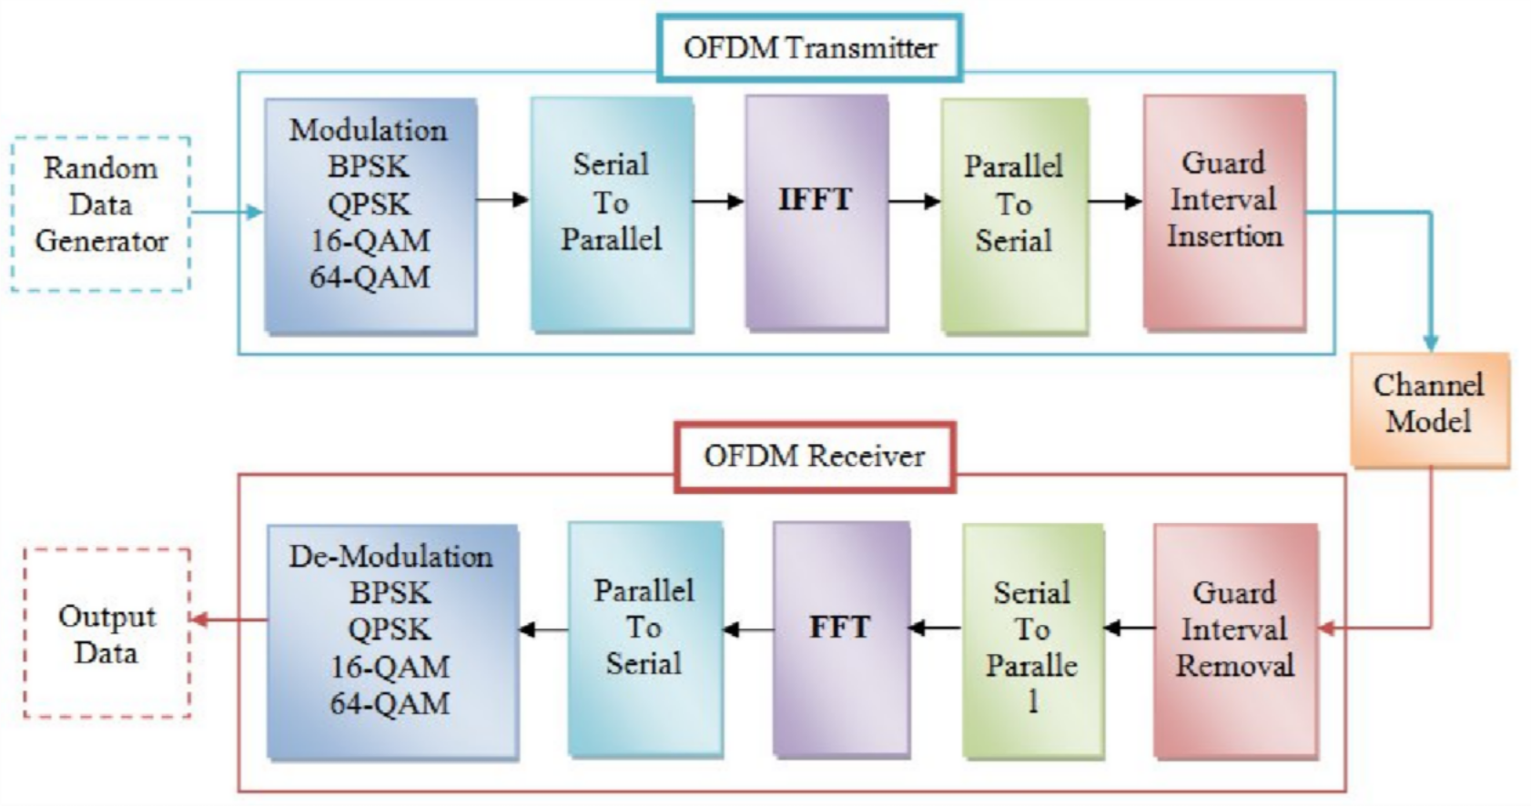

Architecture
Structural Diagram

Slide 9
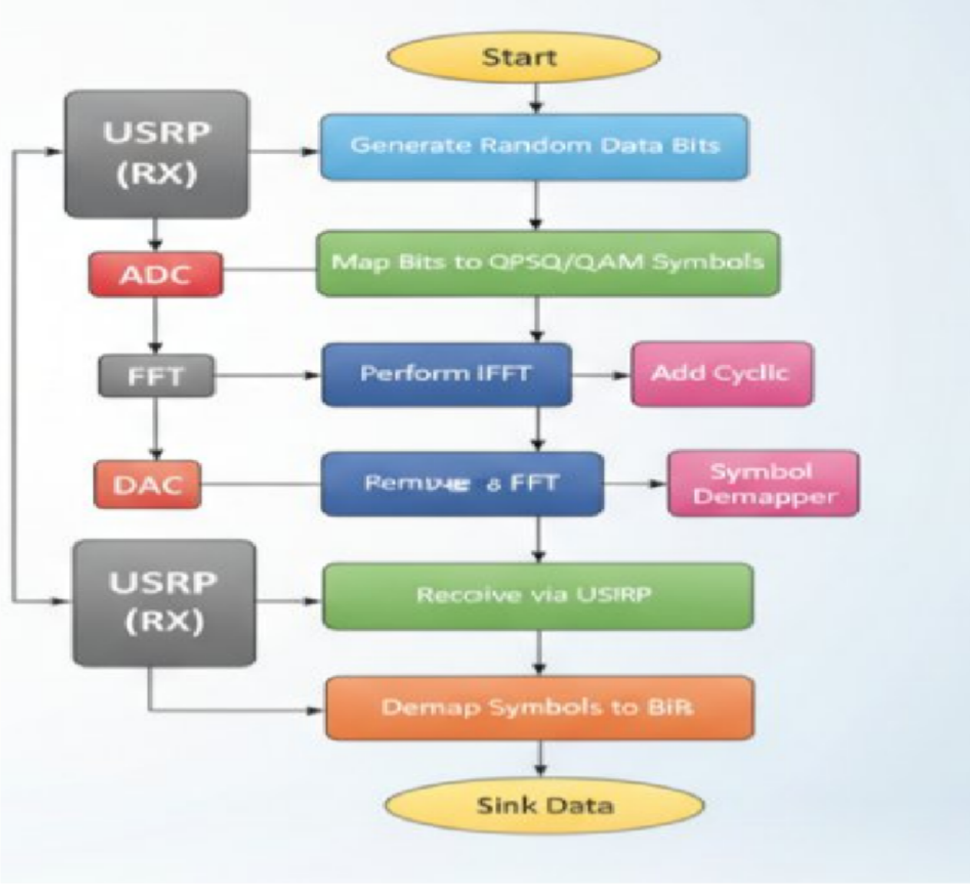

Architecture
Behaviour Diagram

Slide 10

Use Cases & Testing
Use Cases
Wireless communication experiments in labs.
Prototype testing for 4G/5G physical layer.
Research on SDR-based wireless systems.
Educational projects for learning digital communication.
Testing interference handling in wireless channels.
Validating performance of new modulation/coding techniques.
Studying multipath fading effects and mitigation.
Spectrum analysis and efficient bandwidth usage.
Test Cases
Measure BER vs SNR in simulation and hardware.
Check synchronization accuracy (time and frequency).
Spectrum analysis with GNU Radio.
Test under different modulation schemes (BPSK, QPSK)
Performance check under multipath and fading conditions.
Test channel estimation and equalization methods.
Real-time streaming with varying packet sizes.
Compare power efficiency and spectral efficiency.

Slide 11

Conclusion & Future Work
Summary and Conclusion
Understood basics of OFDM and its importance in modern communication systems.
Completed project planning and literature survey.
Successfully set up GNU Radio environment.
Started implementing and testing OFDM blocks in simulation.
Established initial communication with USRP B210 hardware.
Identified challenges such as synchronization, channel estimation, and hardware calibration.
Current results show progress towards a working OFDM testbed.
Future Work
•Complete full OFDM transmitter and receiver implementation on USRP B210.
•Perform real-time transmission and reception experiments.
•Analyze BER vs SNR performance in hardware tests.
•Add pilot-based channel estimation and equalization.
•Explore higher modulation schemes (QPSK).
•Document results and prepare for next project review.

Slide 12

THANK YOU
Have a Great Day !
Dept EECE, GST Bengaluru

